Slide 1
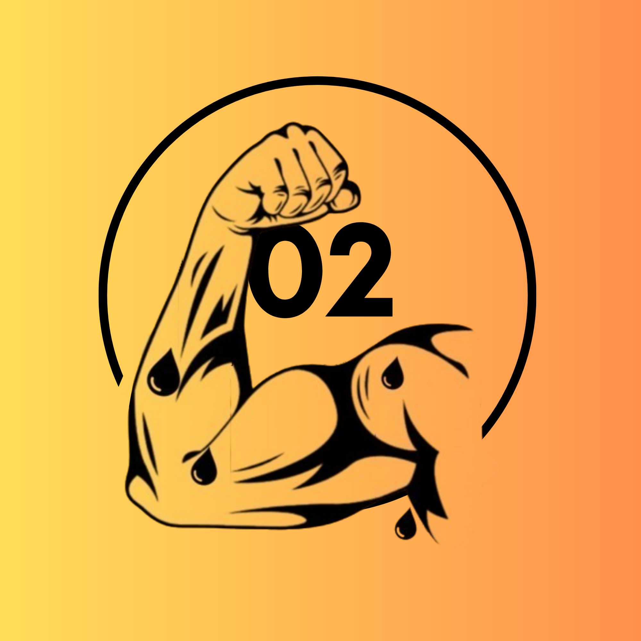
AI Vibe Coding Experiment
SWEaters United - Team 02

Slide 2
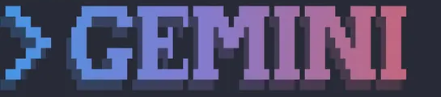
Initial 50 runs
Used the gemini-3.1-flash-lite-preview model with the Gemini CLI
General Observations:
Used emojis for slots
Were able implement diverse art styles and visual effects
App Assessment:
Humor presents after spinning the slot machine
Gemini favors corporate theme or futuristic theme
Code Assessment:
Some generated single html file, others generated CSS and JS files separately
Those with 3 files are easier to read and generates the strongest candidates

Slide 3
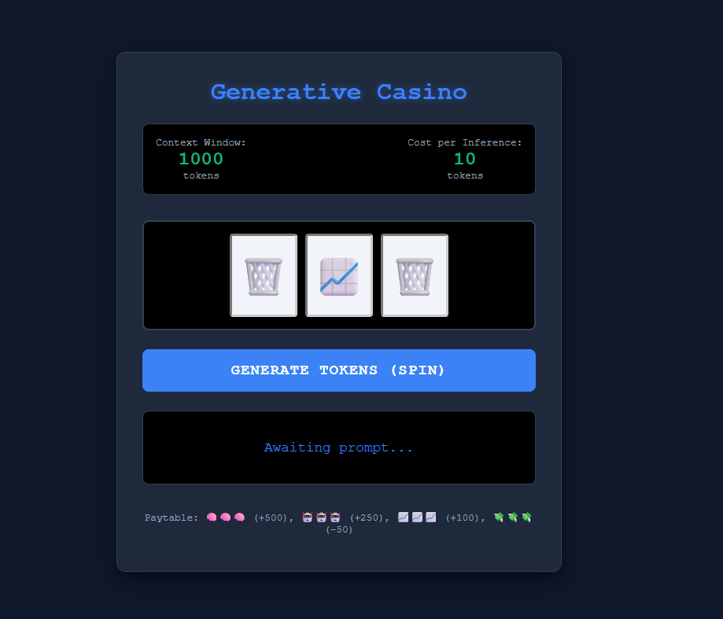
First Runs 50 → 5
Candidate: 01
Reasoning:
Candidate 4 design
Candidate: 04
App Functionality was Paramount
UI more intuitive
Has defined color scheme
Clear theme throughout the generated website
Clear distinction between CSS, HTML, and JS made it easier to read the code
Candidate: 10
Candidate: 45
Candidate: 37

Slide 4
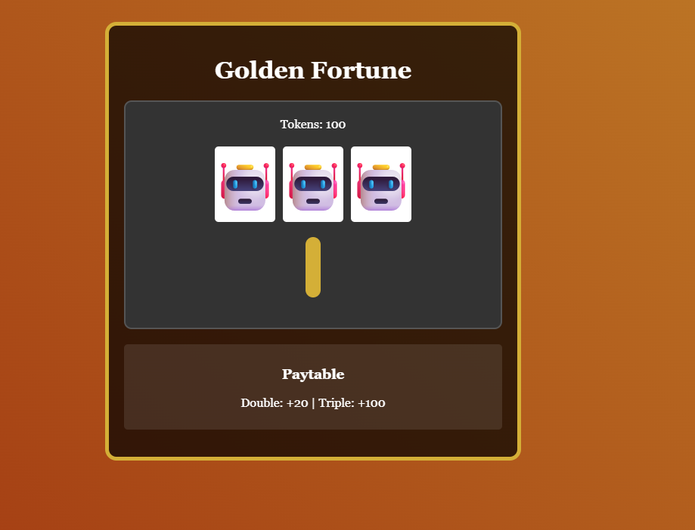
Refinement 5 → 3
Candidate: 01
Candidate: 37
Candidate: 45
Reasoning:
Bombarded prompt with extra features to add (lever, sound effects, paytable) for more fun experience. Also suggested better looking design.
Candidate 10 and Candidate 04 took completely new direction and are no longer functional
Candidates chosen contains:
Working products
Clear color schemes / themes
Followed instructions best (included amount of tokens remaining, paytable, and lever)
Candidate 37 design

Slide 5
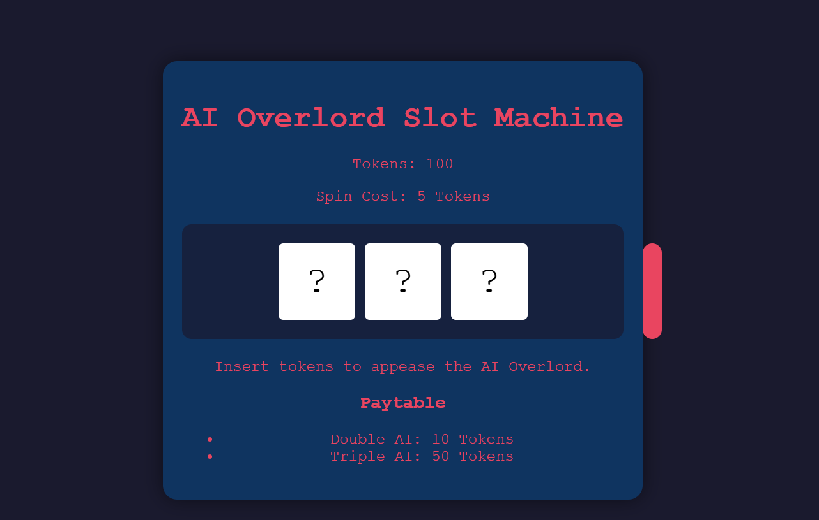
Refinement 3 → 2
Candidate: 01
Candidate: 45
Candidate 45 design
Reasoning:
Addressed pitfalls of the runs trying to implement the features in previous prompt (fix lever bugs and slot spinning). Prioritized basic features of slot machine while relaxing additional features in previous prompt like extravagant design.
Gemini followed instructions decently across all candidates
Design was the biggest factor
Candidate 01: Included animations, humorous comments, and paytable, clear color schemes, clear color schemes
Candidate 45: Additional sound effects
Candidate 37: Lack of distinct colors for the machine (worse UI)

Slide 6
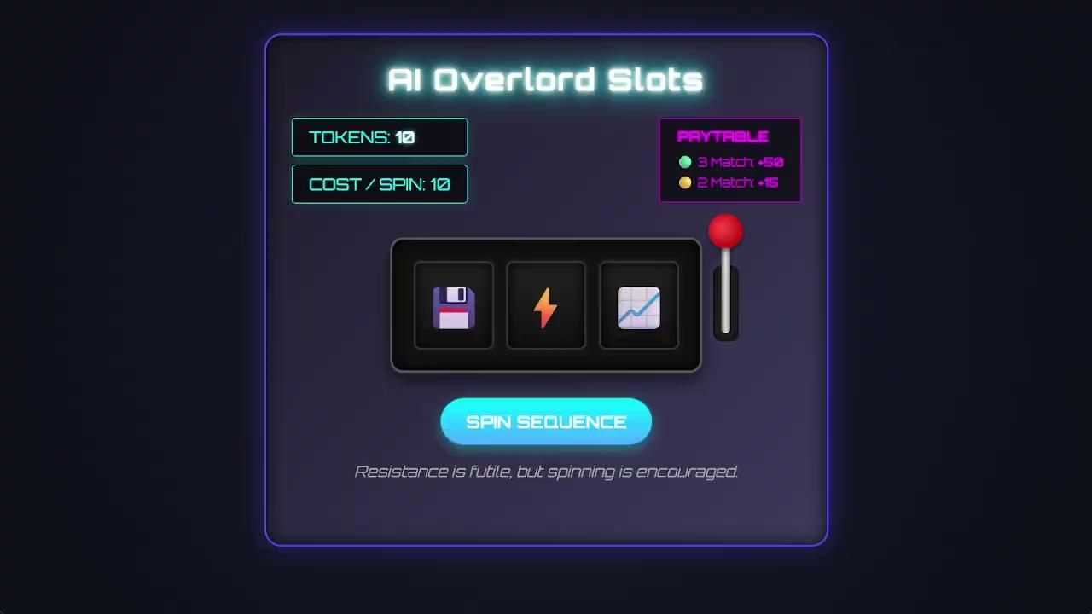

Refinement 2 → 1
Candidate: 01
Removed unnecessary description of basic slot machine behavior and 3 file organization (CSS, JS, HTML). Emphasized AI satire and new minigame for when no tokens.
Minigame more functional then compared to competitor
Better overall visual effects (confetti / animations)
Better aesthetic → Futuristic look
Candidate 1 minigame
Candidate 1 demo

Slide 7

Final Thoughts
What Worked Well
Final App Met Prompted Goal
Code runs without error
Had proper scoring system
Had some AI satire / Joke
Was a functional slot machine
Contains behaviors that mocked AI
What Didn’t Work Well
Was Code Easy to Understand
UI was lackluster
Slot machine lever was buggy
Couldn’t interact / press
Some features were not addressed in prompt
Code was easy to read and understand for the most part with some comments
Organized structure
Still has room for improvement
No Concrete Pattern in how Gemini produced the app

